Slide 1
Computer Engineering Department
A.P. Shah Institute of Technology
G.B.Road,Kasarvadavali, Thane(W), Mumbai-400615 UNIVERSITY OF MUMBAI
Academic Year 2022-2023

Slide 2
Hospital Management System
A Project Report on
Submitted in partial fulfillment of the degree of
Bachelor of Engineering(Sem-VI)
in
Computer Engineering
By
Mahek Chougule (20102184)
Anjali Divekar (21202105)
Vaishnavi Dhumal(21202146)
Under the Guidance of
Prof. D.D. Kayande

Slide 3
1.Project Conception and Initiation

Slide 4
1.1 Abstract
In today's world, the healthcare industry is a vital part of our society. The healthcare industry's operations involve the management of patient information, scheduling appointments, managing medical records, and many other tasks. The traditional paper-based methods of managing these tasks are inefficient and time-consuming, leading to errors and delays in patient care. A hospital management system is a critical software application that helps healthcare providers manage their operations efficiently.

Slide 5
1.2 Objectives
To design an efficient database schema that can handle complex relationships between entities such as patients, doctors, and medical procedures while ensuring data protection and security.
To develop a user-friendly and intuitive interface that can be easily used by healthcare providers with minimal training.
To provide healthcare providers with an efficient and reliable way to manage their operations and improve patient care.
To host the system on AWS, providing scalability, reliability, and security features that ensure the system remains operational and secure.
To improve the efficiency of healthcare operations by providing healthcare providers with a platform to manage patient information, appointment scheduling, and billing information efficiently.

Slide 6
1.3 Problem Definition
The healthcare industry is one of the most critical industries globally, and efficient management of healthcare operations is crucial to ensure high-quality patient care. The traditional paper-based methods of managing healthcare operations can be time-consuming, error-prone, and inefficient, leading to delays in patient care and increased costs. Hospital management systems can help healthcare providers manage their operations more efficiently and improve patient care.
Another problem is designing a user-friendly and intuitive interface that can be easily used by healthcare providers with minimal training. The interface must provide easy access to patient information, appointment scheduling, and billing information.

Slide 7
1.4 Scope
The system will be a web-based application that can be accessed from any device with an internet connection.
The system will be designed to manage hospital operations such as patient information management, appointment scheduling, and billing information management.
The system will be designed to be user-friendly and intuitive, allowing healthcare providers to manage their operations efficiently with minimal training.
The system will be designed to be scalable, reliable, and secure, ensuring that healthcare providers can access patient information and manage their operations from anywhere at any time.
The system will be hosted on the AWS cloud platform using EC2 instances, providing scalability, reliability, and security features that ensure the system remains operational and secure.

Slide 8
1.5 Technology stack
Front-end: HTML, CSS, JS
Back-end: PHP
Software used: XAMPP
IDE used: VSCODE

Slide 9
1.6 Benefits for environment & Society
Reduced paper usage: The use of a web-based application and electronic records can significantly reduce the need for paper records, reducing paper usage and saving trees.
Energy-efficient hosting: The use of AWS cloud platform with EC2 instances ensures that the system is hosted in an energy-efficient manner, reducing the carbon footprint and promoting sustainable practices.
Improved patient care: The hospital management system project aims to improve hospital operations and patient care by providing healthcare providers with a user-friendly and efficient way to manage their operations. By improving patient care, the project can have a positive impact on society.
Accessibility: The web-based application can be accessed from any device with an internet connection, making it more accessible for healthcare providers who work remotely or in remote areas.

Slide 10
2. Cloud Technology

Slide 11
2.1 Cloud Platform
We have opted to use AWS service to deploy our project on the cloud. This allows us to leverage the scalability, reliability, and security features of AWS to ensure seamless deployment and management of our project. With AWS, we can easily monitor and manage our resources, ensuring optimal performance and efficiency.

Slide 12
2.2 Services Used
The project is hosted on an EC2 (Elastic Compute Cloud) instance, which is a virtual machine that provides computing resources for the project. The EC2 instance runs the Apache web server, which is used to serve the web pages for the application. The instance is configured with a security group that allows traffic only from specified IP addresses, ensuring that the project is secure from unauthorized access.
By using EC2 instances, the hospital management system can take advantage of AWS's scalability, reliability, and security features. EC2 instances can be easily scaled up or down depending on the demand for the application, allowing healthcare providers to access patient information and manage their operations without interruption.

Slide 13
3.Implementation

Slide 14
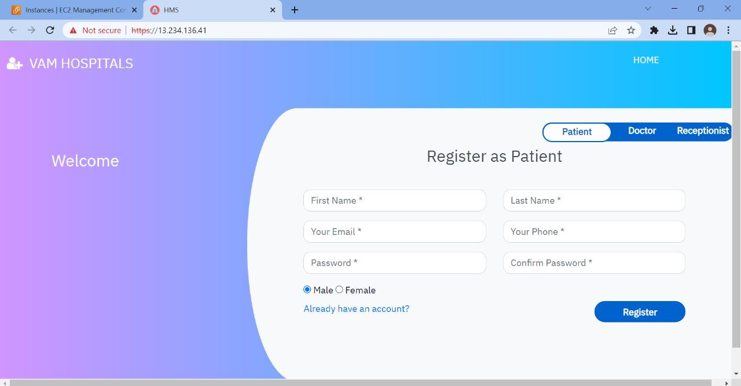
3.1 Execution

Slide 15
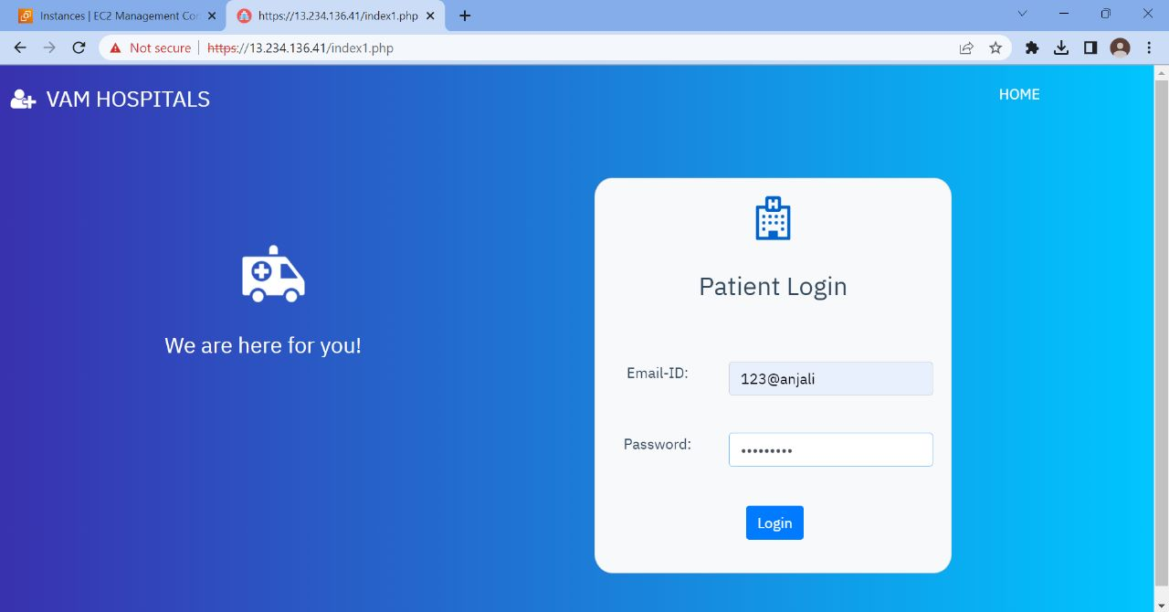

Slide 16
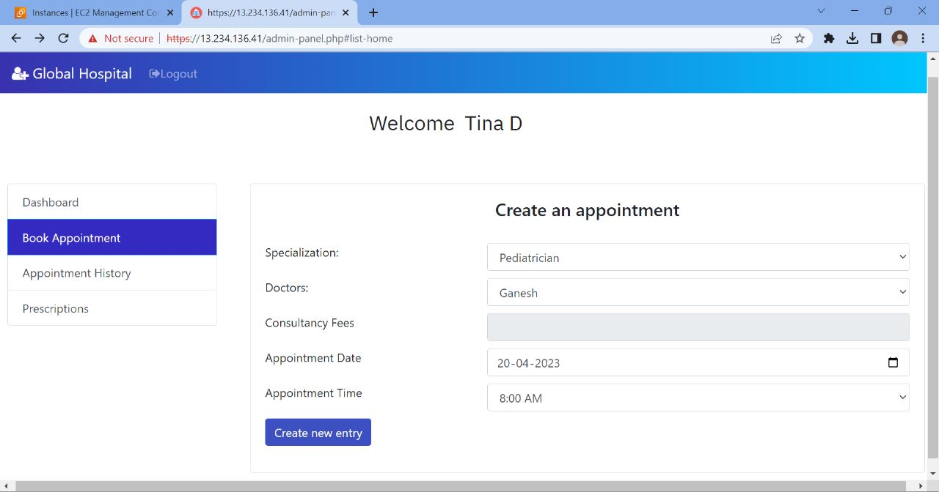

Slide 17
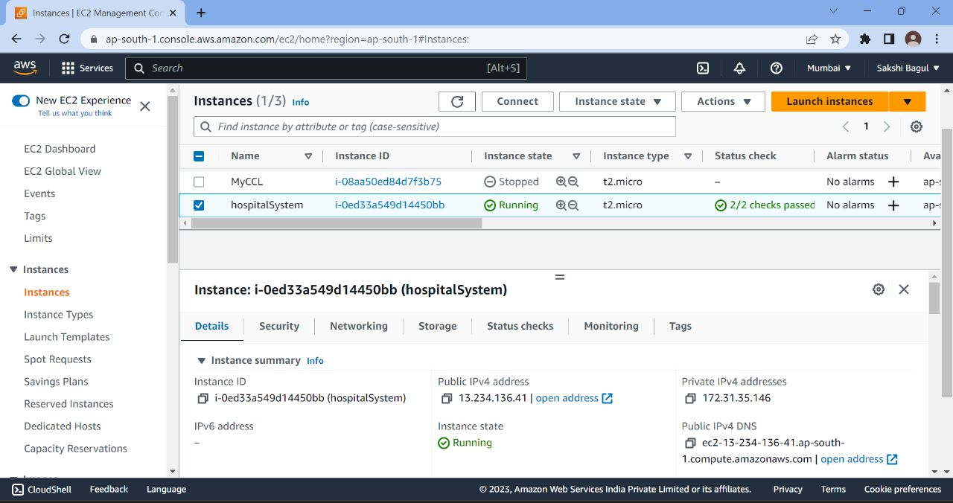

Slide 18
5. References
Journal of Computer Applications, vol. 108, no. 4, pp. 1-4, December 2014.
A. Garg, N. B. R. Subramanya, and G. R. Kini, "Design and Implementation of Hospital Management System Using PHP and MySQL," International Journal of Emerging Technology and Advanced Engineering, vol. 3, no. 3, pp. 66-70, March 2013.
S. P. Singh and P. Kumar, "Hospital Management System: A Review," International Journal of Advanced Research in Computer Science and Software Engineering, vol. 4, no. 7, pp. 847-852, July 2014.
A. M. A. Al-Ali and M. A. El-Mahallawy, "Cloud Computing in Healthcare: A Literature Review," Journal of Healthcare Engineering, vol. 2018, Article ID 9096061, 12 pages, 2018.
R. K. Singh and R. C. Jain, "Design and Development of Cloud-Based Hospital Management System Using AWS," International Journal of Computer Sciences and Engineering, vol. 6, no. 11, pp. 283-287, November 2018.

Slide 19
Demonstration and Code Links
https://github.com/anjalid26/Hospital-Management-System

Slide 20
Thank You

